Slide 1


Slide 2
Automated Detection and Analysis of IoT Network Traffic Through Distributed Open Source Sensors and Citizen Scientists
Joe McManus
Interdisciplinary Telecommunications Program
University of Colorado

Slide 3
About Me
Currently:
Prof CU Boulder
Sr Cyber Researcher CMU/SEI
CISO Automox
Past
Director of Security SolidFire
Sr Research Manager Webroot

Slide 4
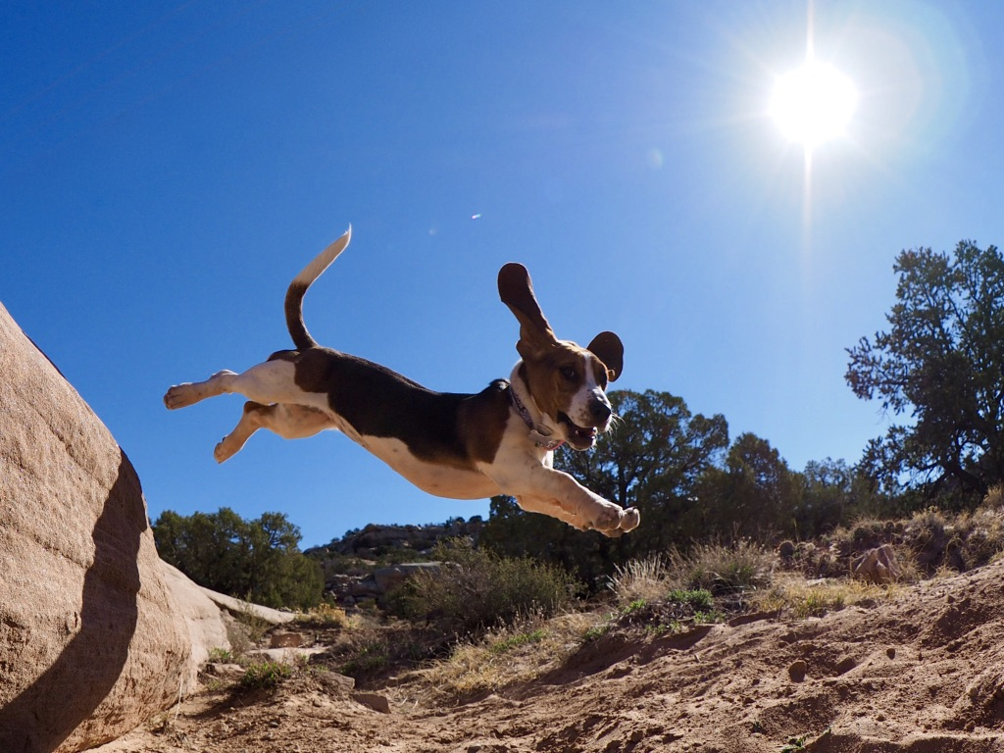

Slide 5


Slide 6
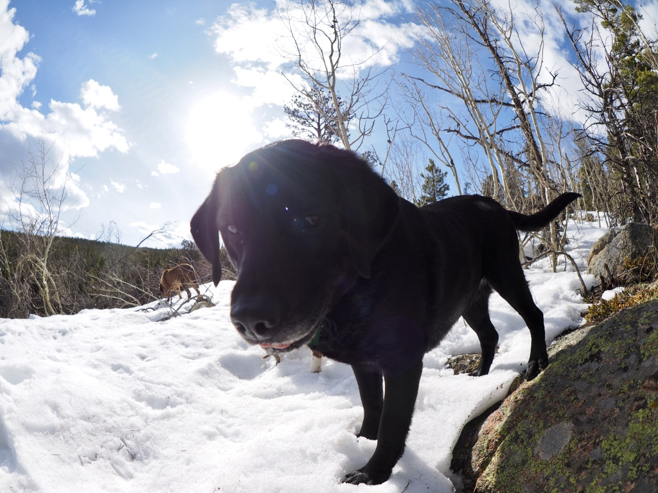

Slide 7
How did this come to be?
A security company hired me to create their IoT security product, an agent based security product.
Does not scale.
ESP8266
ARM
Atmel
etc

Slide 8
Question
Can we secure the Internet of Things through network based detection leveraging low cost distributed sensing?

Slide 9


Example of Citizen Scientists
SETI@home
Weather Underground
NASA
CitizenScience.gov

Slide 10


Slide 11
Sub Question 1
Using machine learning of network data can distributed analysis and collection of network behavior be used to generate intrusion detection signatures and firewall rules?
Why not just use a firewall?
Home users do not understand NAT/PAT

Slide 12
Sub Question 2
Can a low cost sensor network be designed to empower citizen scientists collect data that will be used secure the IoT?
NetFlow , DNS, IP Reputation
Must be affordable (<$200)

Slide 13
Sub Question 3
Can effective visualization and machine learning be used to develop tools that will represent a large amount of network data to allow citizen scientists to quickly analyze and respond to the collected data?
Visualizations that will encourage the user to explore the data
Do not rely on static signatures

Slide 14
Problem Space
5/11/2017 – Persirai malware infected 100,000 IP cameras made by overseas manufacturers. Actively being used in DDoS campaign.
Based on a variant of the Mirai BotNet which caused interruptions to Akamai and many other sites by attacking DNS providers.

Slide 15
Mirai as an Example
Why is Mirai a good example ?
Even though we use the term Malware, this was not what we’d classify as malicious traffic
There was no malicious payload
The attack used a list of 50 default usernames and passwords.

Slide 16
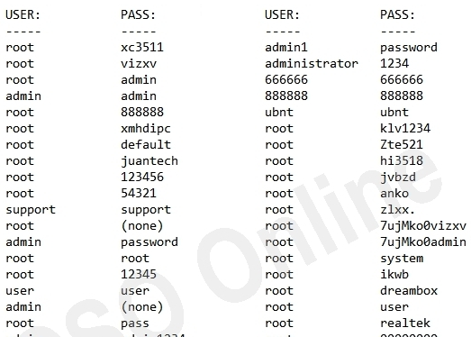
Mirai Names and Passwords

Slide 17
Problem Space
2/2/2016 Fischer Price patched vulnerability in API of toys that exposed data (audio and video) to attackers.

Slide 18
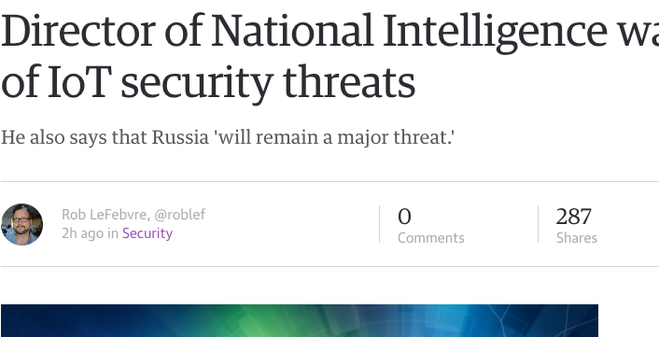
Problem Space

Slide 19
Progress
Sensor
The sensor platform is built
Collecting data in 3 installations(have 15 ready to deploy)
Cloud
Cloud server is accepting data
Processing and determining type
Honeypot
Collecting flow traffic in a public IoT Honeypot
Testing
Promising with 93% success rate

Slide 20
Sensor Network

Slide 21


Slide 22
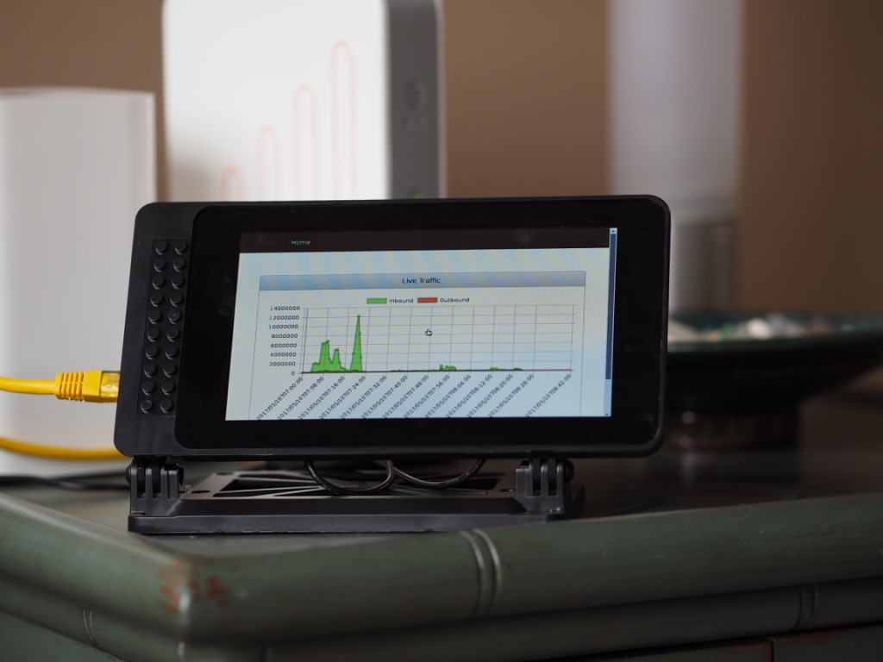
Sensor

Slide 23
Sensor
The sensor is built on the Raspberry Pi 3 with a 7” touchscreen display.
Data is collected using:
NetFlow (SiLK)
DNS (Python)
IP Reputation (Python)
MQTT for data transmission

Slide 24
Visualization
Traffic flow
DNS Information
Security Alerts
Protections

Slide 25
Protection
As data is analyzed IP or hostname is determined to be bad and MQTT alerts the sensors to block or quarantine traffic.
Using a software defined network(SDN) certain traffic that is not known bad yet can be rate limited and ACLs are put in place to protect.

Slide 26
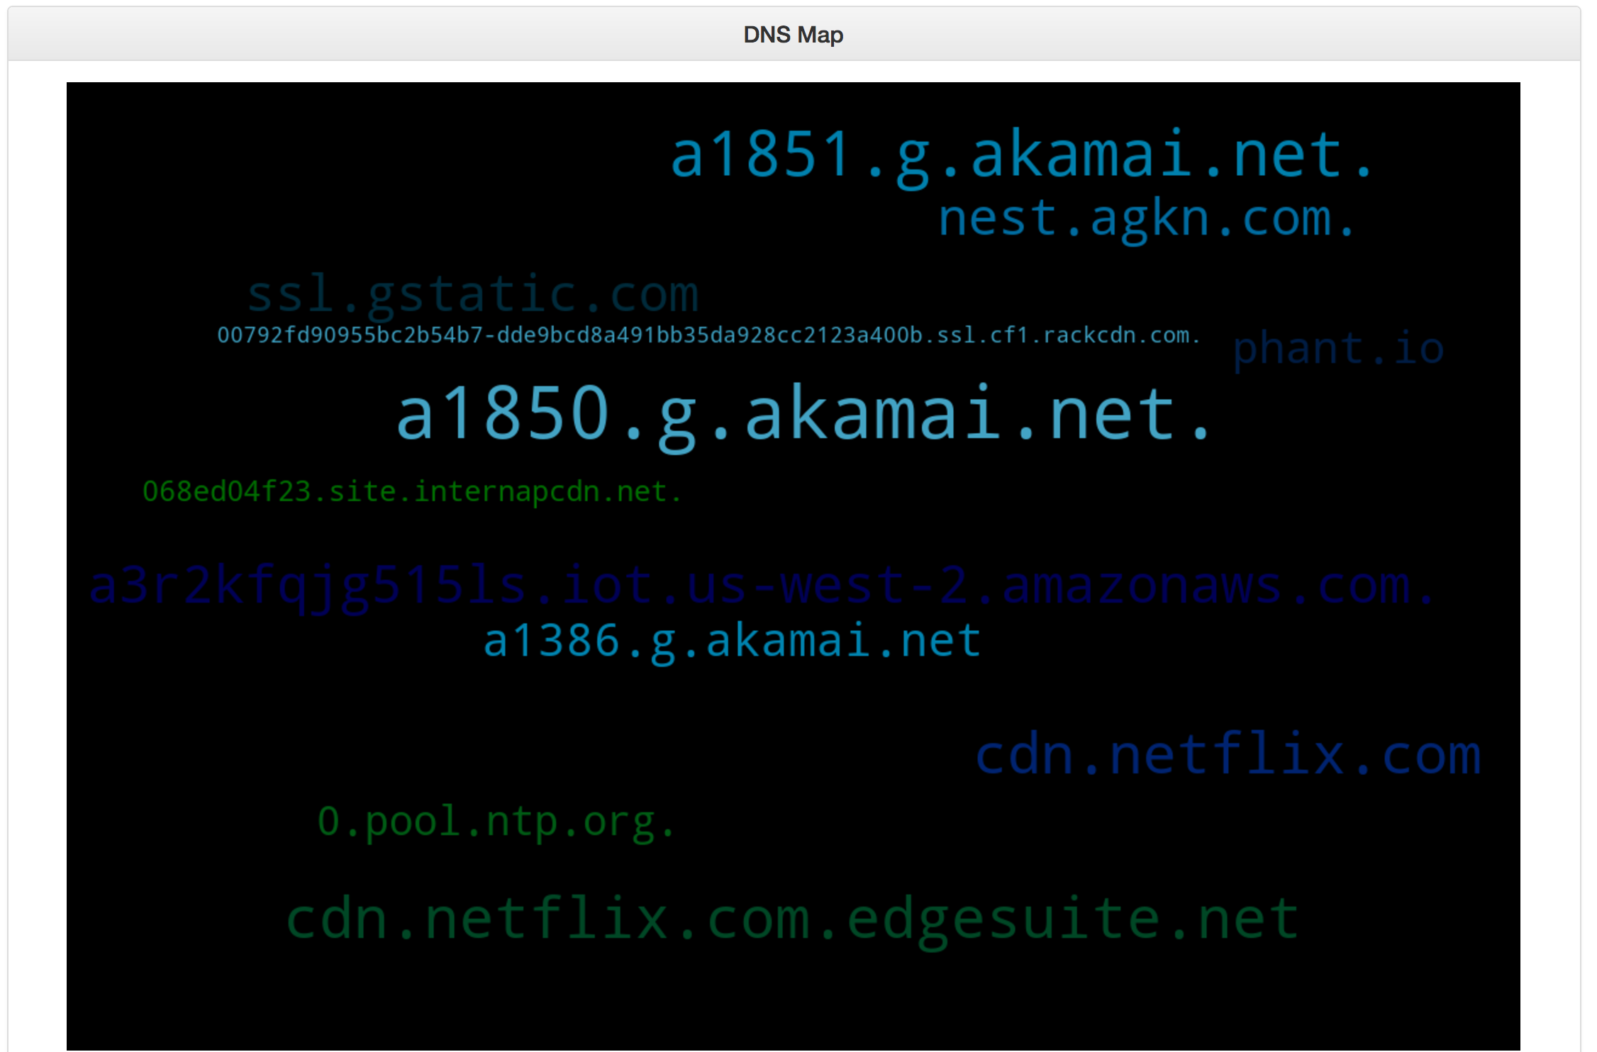
DNS

Slide 27
Traffic

Slide 28
Sensor UI improvements
Allow users to mark traffic as bad/good.
With enough data push out rules to all.
For that use black hole or rate limit using SDN.
Allow users to subscribe to “paranoid”.

Slide 29
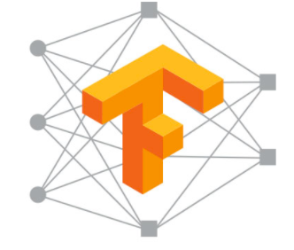

Cloud Environment
Linux Servers
Restful API
Flask
Chart Graphing
TensorFlow
MQTT

Slide 30
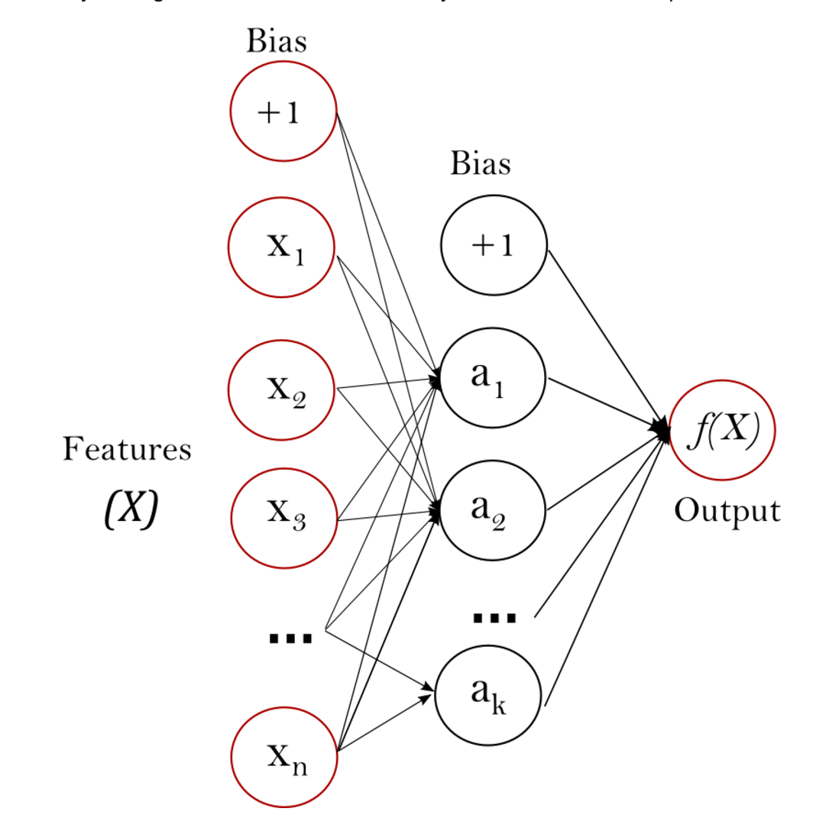
Machine Learning
Machine learning will be performed using TensorFlow
Use a supervised neural network
Multi Layer Perceptron

Slide 31
Test Data
Training Data was used as follows:
80,000 known malicious traffic flows
10,000 known good traffic flows.
10,000 mixed traffic (5000 bad flows)

Slide 32
Training Data
Malicious Traffic | Good Traffic | Testing Traffic
Reconnaissance: 30,000 Ports scanned using NMAP- TCP, UDP and SYN scans. Brute Force Password Attack:40,000 login attempts using SSH and Hydra SQLi and XSS: W3AF Framework used to test IoT application for two of the top ten OWASP vulnerabilities. | IoT Device transmitting data in real time. (Web Camera) IoT Device configuration updates. (Thermostat) IoT Device streaming media (Roku Media Player) | NMAP Xmas Scans, non randomized scans. IoT Traffic (Smoke Detector) IoT Traffic (Alarm System) Nikto Web Server Scan Customized Mirai Botnet Code

Slide 33
Results
With the initial training data set loaded the system was able to correctly identify previously unseen attacks with 93% accuracy.

Slide 34
Honeypot
Honeypot of IoT devices on the public internet
There is no inbound traffic that is non-malicious
All of this data is fed to the machine learning environment as known bad

Slide 35
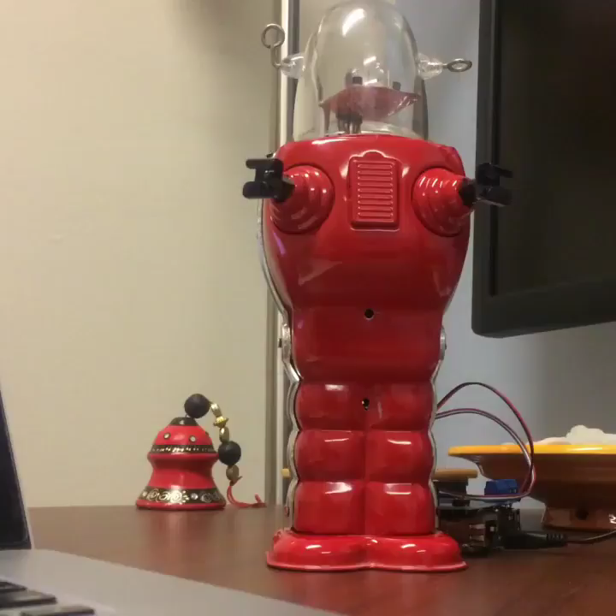
Honeypot

Slide 36
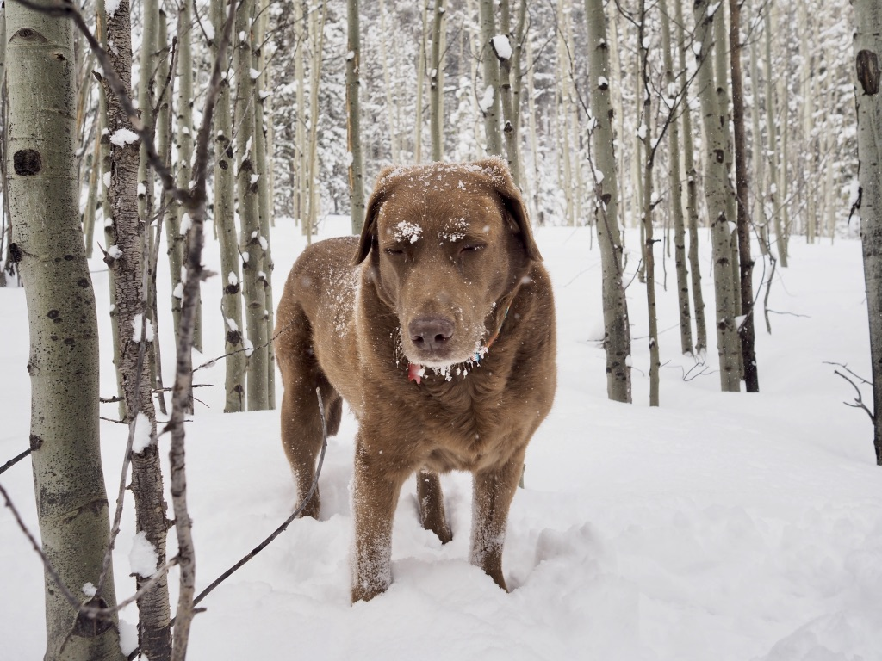

Slide 37


Slide 38
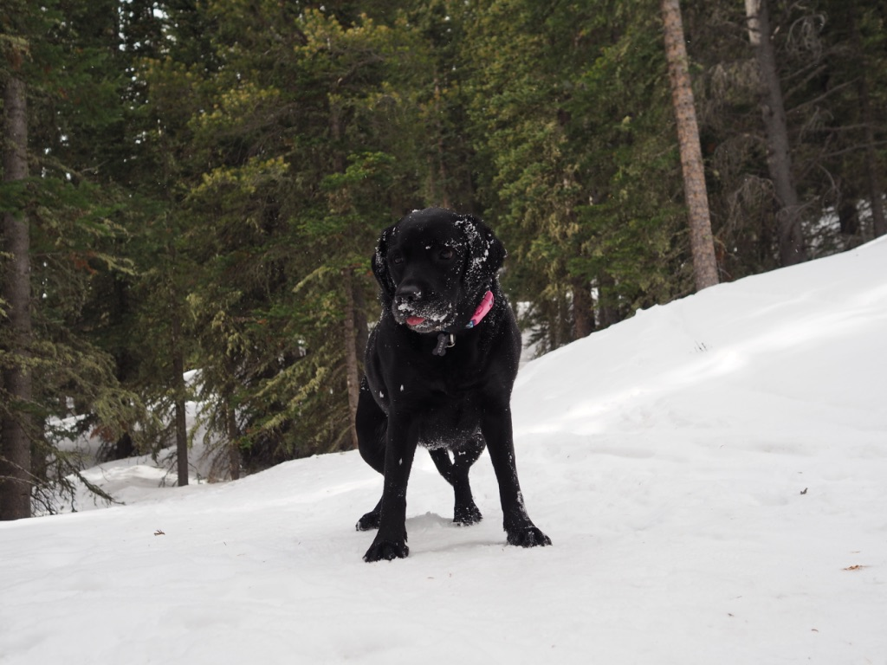

Slide 39
Further Work
Move cloud to EC2
Create auto-update feature of sensors
Distribute sensors to test group
Increase DNS analysis
Improve UI

Slide 40
Thank You
Questions?
joe.mcmanus@colorado.edu

Slide 41
